Slide 1
Energy
Please fill in your notes sheet as we go through the PowerPoint presentation.

Slide 2
What is energy?
Energy is the ability to do work or cause change.
Work occurs when a force, or a push or pull on something, causes an object to move or change position.
When an object moves, it is in the same direction as the push or pull (force).
The units for energy (work) are joules.
Everything in the world has energy!

Slide 3
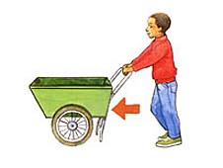
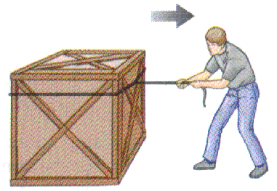
Push
Examples of Forces
Pull

Slide 4
Two Types of Energy
The two main types of energy are called kinetic energy and potential energy.
Kinetic energy is the energy of motion.
Potential energy is the energy of position or shape.

Slide 5
Kinetic Energy
An object has kinetic energy when it is moving.
If an object has kinetic energy, it can “do work” on another object to transform its potential energy into kinetic energy.

Slide 6
Kinetic Energy
The amount of kinetic energy something has depends on two things, speed and mass.
The faster an object is moving, the more kinetic energy it has.
The more mass an object has, the more kinetic energy it has.

Slide 7
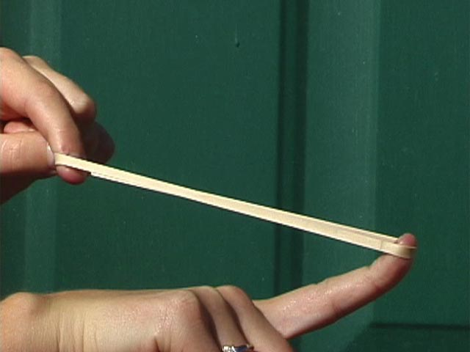
Potential Energy
An object has potential energy when it is not moving (at rest).
It has the POTENTIAL to be converted into other types of energy, such as kinetic energy.

Slide 8
Mechanical Energy
Mechanical energy is all the energy an object has, both kinetic and potential.
An object will always have the same amount of mechanical energy.
Potential energy can become kinetic energy and vice versa!

Slide 9
Potential→Kinetic
The only way a non-living thing can transform its potential energy into kinetic energy is if a force (gravity) acts on it.
When an object at rest begins to move, it loses potential energy and gains kinetic energy.

Slide 10
Kinetic→Potential
A moving object with kinetic energy can become an object at rest with potential energy.
As a moving object runs out of kinetic energy, it loses kinetic energy and gains potential energy.

