Slide 1
States of Matter
Please fill in your notes sheet as we go through the PowerPoint presentation.

Slide 2
What is matter?
Matter is anything that has volume and mass.
In other words, matter is everything around you!!!
Matter can exist as a solid, liquid, or gas and it can change from one state to another.

Slide 3
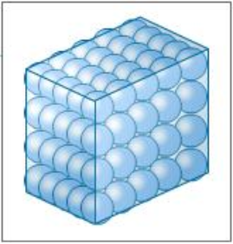
Solids
Solids have a definite shape and volume.
The molecules of a solid are tightly packed and vibrate in place.
What are some examples of solids?

Slide 4
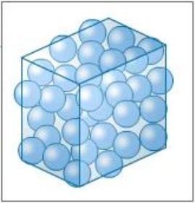
Liquids
Liquids have a definite volume, but can take the shape of the container they are placed in.
The molecules of a liquid are close together and move around slowly.
What are some examples of liquids?

Slide 5
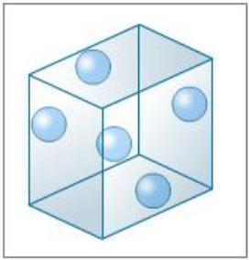
Gases
Gases do not have a definite shape or volume.
The molecules of a gas are far apart and fast moving.
What are some examples of gases?

Slide 6

Changing State
Matter can change from one physical state to another when energy is added or taken away.
This happens when there is a change in temperature or pressure.

Slide 7
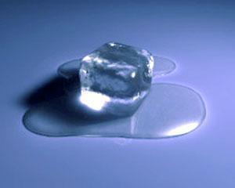
Melting
Melting is the phase change from a solid to a liquid.
The molecules speed up and move away from each other.
The melting point of water is 0°C (32°F).

Slide 8
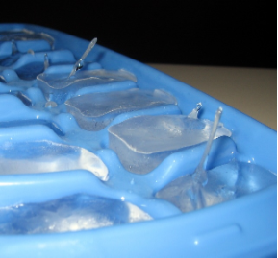
Freezing
Freezing is the phase change from a liquid to a solid.
The molecules slow down and move closer to each other.
The freezing point of water is 0°C (32°F).

Slide 9
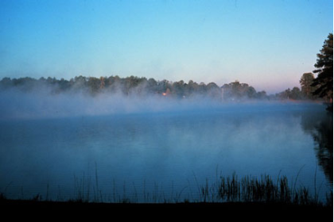
Evaporation
Evaporation is the phase change from a liquid to a gas that occurs below the liquid’s boiling point.
The molecules speed up and move far away from each other.
The boiling point of water is 100°C (212°F).

Slide 10
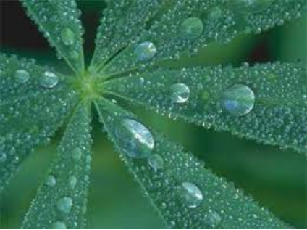
Condensation
Condensation is the phase change from a gas to a liquid.
The molecules slow down and move closer to each other.

Slide 11
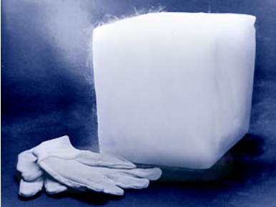
Sublimation
Sublimation is the phase change directly from a solid to a gas.
The molecules speed up and move far away from each other.
This phase change is very rare.

